Slide 1
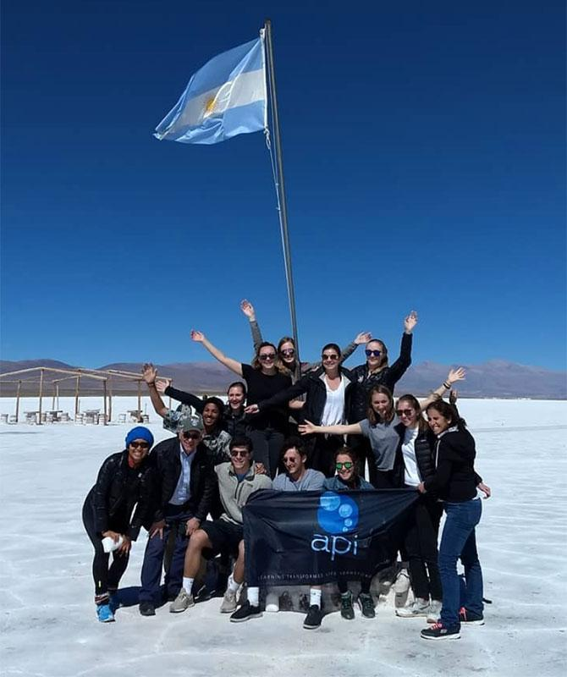

SPANISH VISAS
Experience the World with API

Slide 2

AGENDA
Learn about the Spanish visa process
Answer some FAQs
Experience the World with API

Slide 3
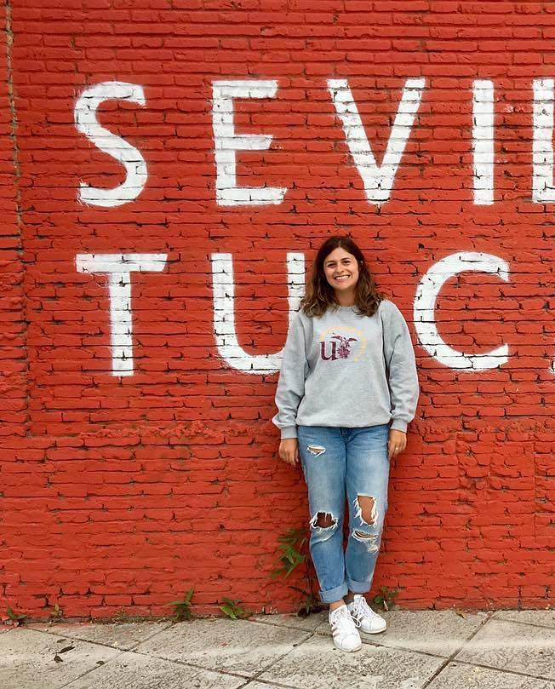
Do I Need a Visa?
Required for U.S. Citizens going abroad for 90 days or more
International participants that do not have Spanish or Schengen citizenship (check your country’s consulate website for more details!)
Check

Slide 4
VISA PROCESS AND TIMELINE
Please note that the times below are estimates only. Exact processing time varies by consulate. Check with your consulate for specific timeline and requirements!
8-12 weeks before departure:
Submit required documents to consulate for processing.
2-4 weeks before departure:
You will receive your passport with the visa affixed inside.
STEP 1
STEP 2
STEP 3
STEP 4
SUCCESS!
4-6 months before departure:
Identify your consulate.
Make visa appointment.
Gather required documents.
Processing typically takes 4-8 weeks.
Your passport will stay at the consulate.

Slide 5
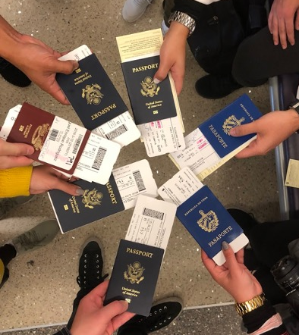
Visa Process and Timeline
It typically takes 4-8 weeks to issue a visa once the application has been submitted. Processing time varies by consulate.
Rushed or expedited service is not available. Visa processing cannot be expedited - please plan accordingly!
Visa requirements are set and governed by the immigration policies of the Spanish government.
API cannot influence or control the time it takes to process visas nor check the status of student’s applications.
It is the student’s responsibility to obtain the appropriate visa before departure.
REMINDER: You cannot travel internationally while waiting for your passport to be returned to you so please do not make any international travel plans during the visa process.

Slide 6
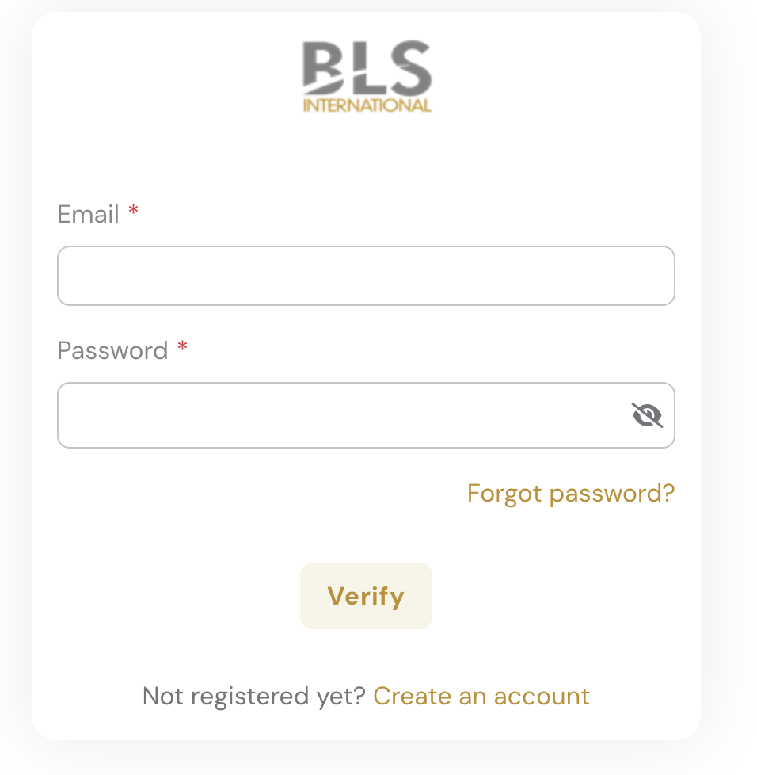
VISA
How do I make an appointment?
Spain has transitioned consular processing for study abroad visas to a third-party organization, BLS. Submissions and pickups must be made through BLS.
Some BLS Application Centers do not require an appointment and allow mail-in visa applications. Check the BLS website for more details
Book the earliest appointment possible at the BLS application center in your jurisdiction.
Check the BLS online booking system multiple times every day for cancellations.
Make sure to book an appointment for National Visa or Student Visa.
You will need a valid passport number to create an account and to book an appointment

Slide 7
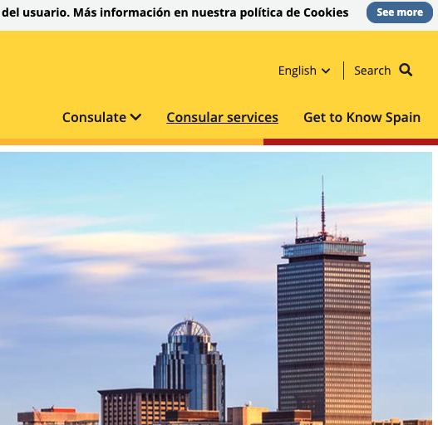

Navigating the Consulate Website
You can find a list of consulates and their jurisdiction here: https://www.exteriores.gob.es/Consulados/boston/en/Consulado/Paginas/Demarcaci%c3%b3n.aspx
Search for the consulate for your jurisdiction. If you search “Spanish Consulate in Boston”, it should be one of the top search results.
If the website is in Spanish, you can change the language by clicking “ENG” on the top right hand side.
Each consulate website is a little different, but you should be able to navigate to a Student/Study Visa and the requirements.
Notes:
Explain that this does not apply to direct bill students.

Slide 8
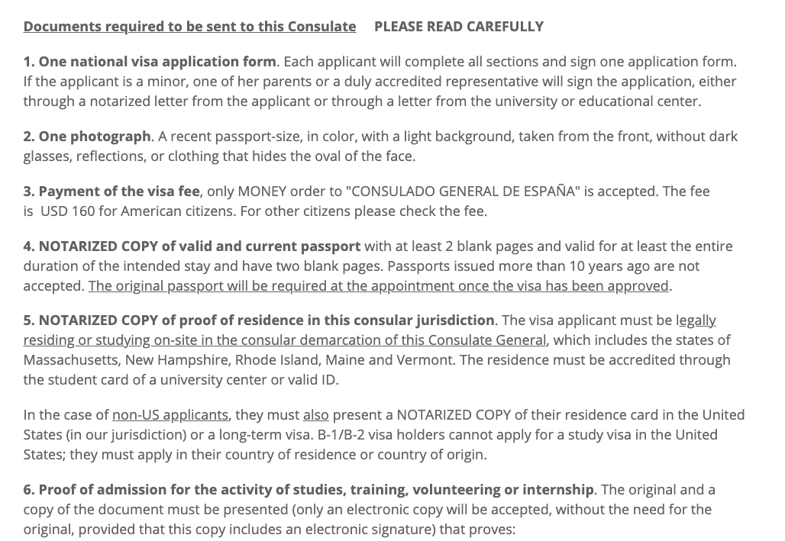
Navigating the Consulate Website
Here you should find a complete list of requirements for your consulate. Please refer to consulate and BLS list of requirements.
You will also find a link to the BLS Application Center for that consulate.
Requirements can change at any time so keep a close eye on the consulate website.
One of the forms you need to fill out is a Visa Application. A sample of this application can be found on the API visa webpage - https://apiabroad.com/student-visas/student-visa-spain/
Notes:
Explain that this does not apply to direct bill students.

Slide 9
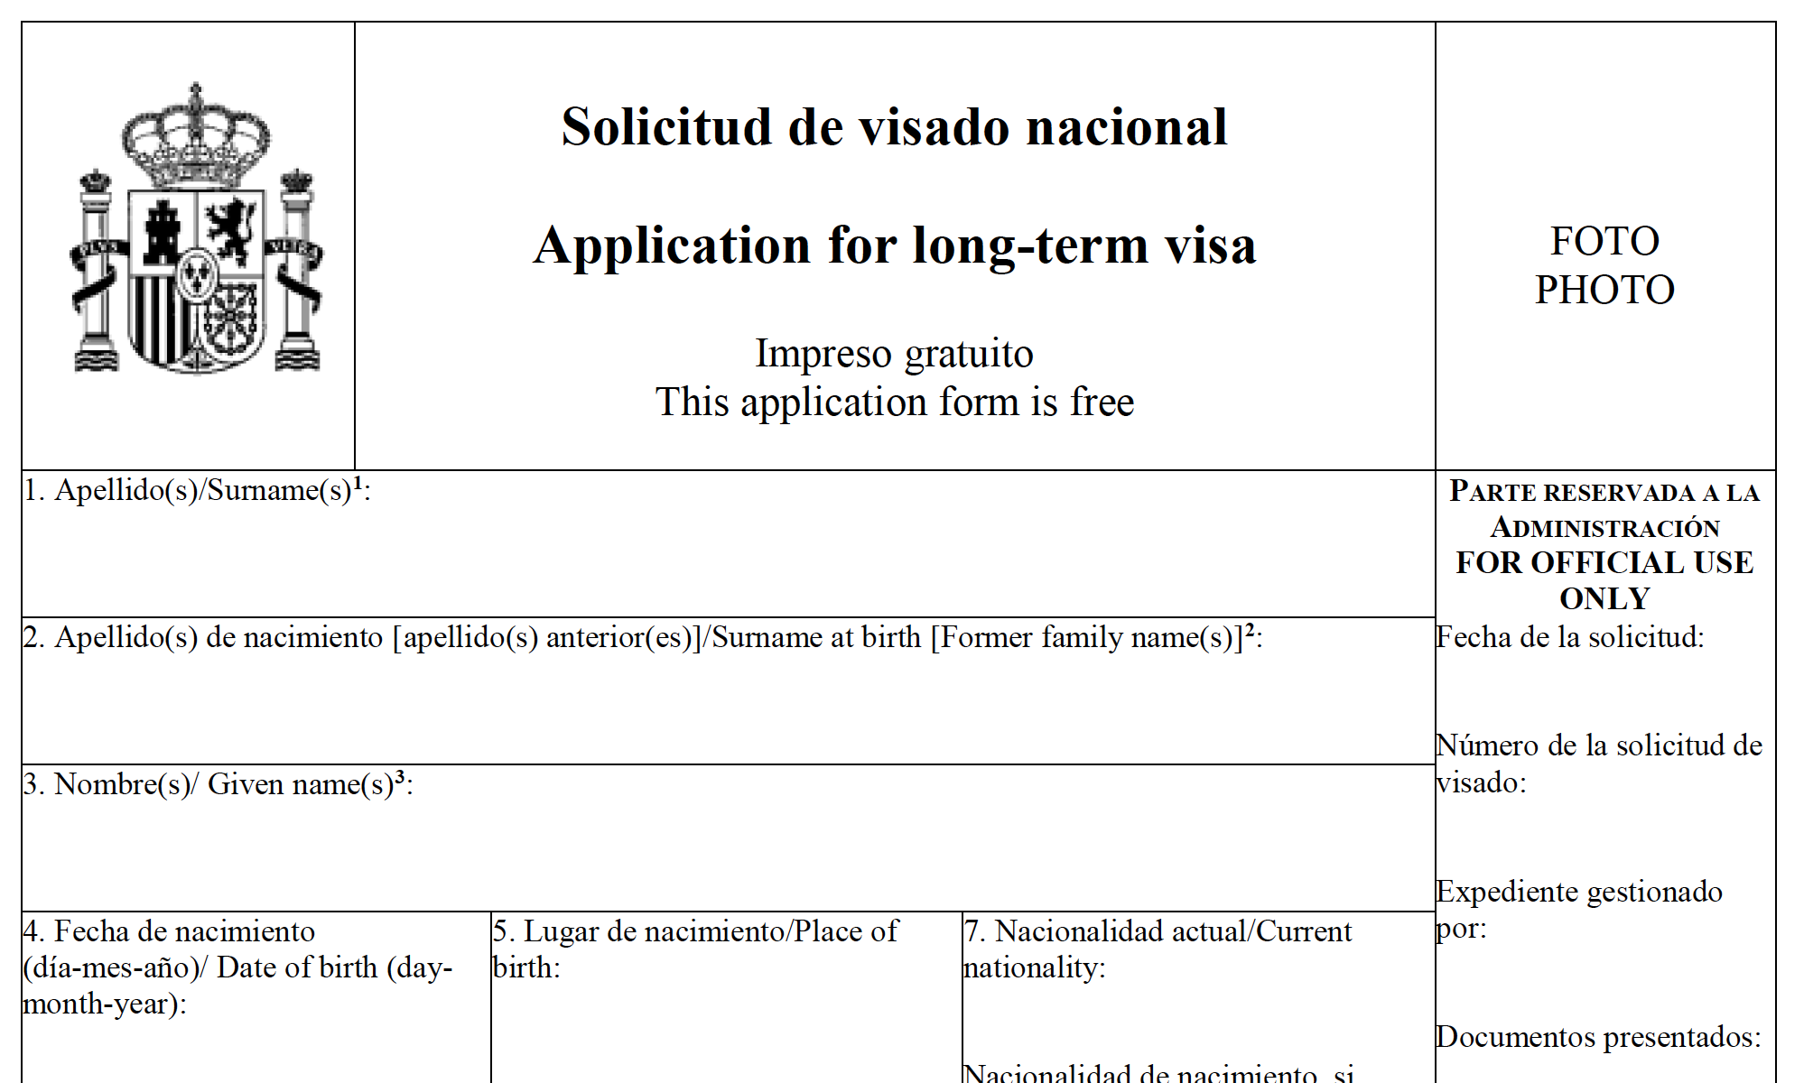
Required Materials
STUDENT IS RESPONSIBLE FOR PROVIDING:
Visa Application Fee
BLS Service Fee
National Visa Application-Application formats can vary by consulate
Physical Passport
Photocopy of the signature/photo page of passport
Recent Passport-size color Photo
Photocopy of your Student ID or Driver’s License
Any other documents that your specific consulate requests, they all have varying requirements

Slide 10


VISA
What documents does API provide?
API Acceptance Letter
Host Institution Enrollment/Acceptance Letter
CISI Insurance Letter (Spanish)
API Visa Letter/ Proof of Enrollment (Spanish)
Housing Letter (Chicago ONLY)
**API will mail all documents highlighted in yellow. Please fill in your Visa Appointment Information in APIConnect so we can have your visa packet mailed to you in time.
**If you need a visa packet expedited this can be arranged for a fee of $35 for 2 day shipping and $50 for 1 day shipping
Experience Madrid with API

Slide 11

Group Visa Service
Who qualifies?
New York, San Francisco, D.C., Houston, Los Angeles, and Boston students
What is it?
API will book an appointment with the Consulate or BLS to batch process student visa applications
You will not need to book your own appointment
Processing fee?
$199
Worth it?
100% YES!! It can be very difficult to get an appointment and this will guarantee you get your visa on time.
What if I miss the deadline?
You can still apply independently
API will be here to support you along the way
Experience Salamanca with API

Slide 12

VISA
General Visa Information: https://apiabroad.com/student-visas/
Spanish Visa Information:
https://apiabroad.com/student-visas/student-visa-spain/
Remember that your consulate is the ultimate resource!
Experience Granada with API

Slide 13
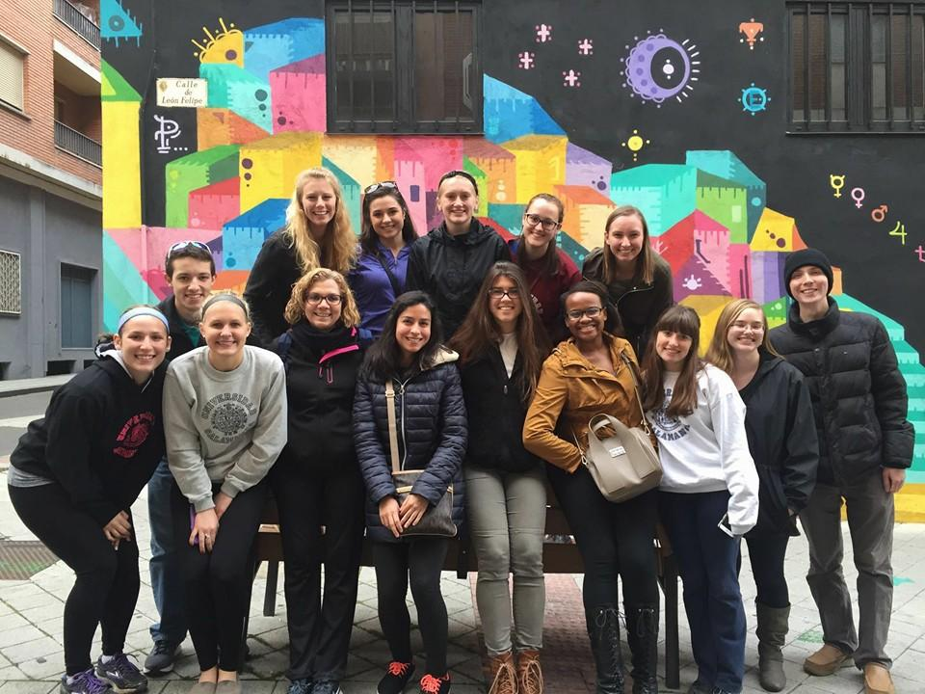
ACADEMIC YEAR STUDENTS
All students going abroad for 180 days or more will be required to obtain a criminal background check.
Criminal background checks must be obtained through U.S. Department of Justice – Federal Bureau of Investigation (FBI)
Legalized with the Apostille of the Hague Convention by the US Department of State in Washington DC.
Background checks and apostilles must be translated into Spanish by a certified translator.
Apostilles can take up to 5 weeks to be processed. Please start this process asap!
Experience Salamanca with API
Notes:
Local background checks will not be accepted

Slide 14

FAQs
Can my parents go get the visa for me?
Some BLS centers will allow submissions through a duly accredited representative
Can a non-U.S. Citizen apply for a student visa through a consulate in the U.S.?
Yes. Students should provide a Permanent Resident Card or US visa with their I-20. The visa application fee will vary based on country of citizenship
Can I pay to have my visa expedited?
Consulates do not have an option for students to have their visa expedited. Students MUST carefully plan their visa appointments to allow enough time for processing.
Experiencing Bilbao with API

Slide 15

FAQs
Do I need to be accepted and enrolled to make an appointment?
You do not need to be accepted to make an appointment, but you do need to be confirmed and enrolled to attend the appointment. We will not release your documents until you have confirmed your participation.
How long does the visa process take?
Consulates are receiving a high volume of applications. It typically takes at least 4-8 weeks to issue a visa but it can take longer. Apply ASAP!
My consulate is very far away/booked up. Is there a consulate closer to me?
Honorary Consulates of Spain cannot process visa applications.
Experiencing Bilbao with API

Slide 16

FAQs
I have an international trip planned before I leave. Can I travel while I get my visa?
Most consulates will keep your passport during processing, as the visa is issued inside the passport. API advises against international travel while completing the visa process.
Can I travel after my program ends?
a student with a U.S. passport enters less than 90 days before their national study visa start date, the student does NOT need to exit and re-enter the Schengen area to activate their national study visa. However, at the end of the study visa period, if the student still has days left in their 90 days out of 180 days Schengen travel permit, and they wish to travel, they DO need to exit and re-enter to activate the Schengen tourist visa. If the student will not be traveling and will not be requesting a study visa extension, they will have 15 calendar days to leave the Schengen area after the end of the study visa period.
Experiencing Barcelona with API

Slide 17
Questions? Send an email to support-visa@apiexperience.com
PHONE 512-600-8900

